Slide 1
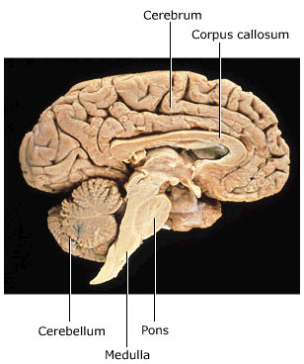
The Brain

Slide 2
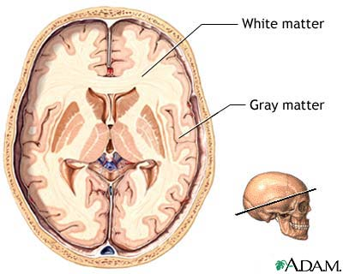
The cerebrum
Outer layer – 2-4mm grey matter (cerebral cortex)
Middle layer – white matter
Inner most layer – grey matter (basal ganglia)

Slide 3
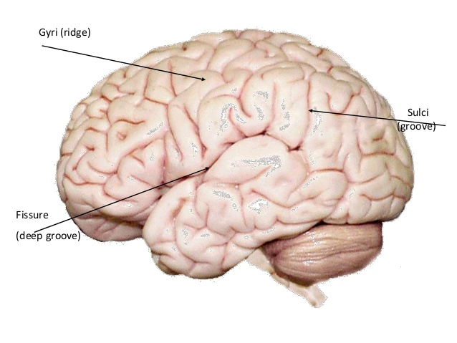
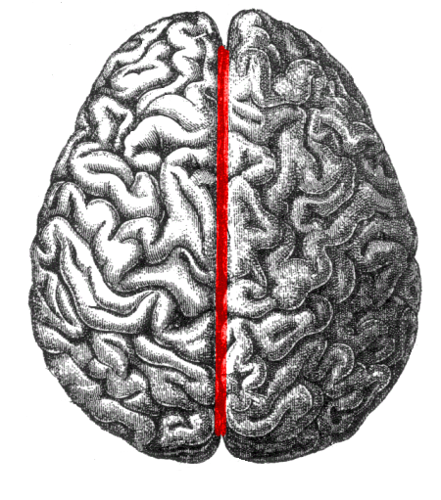
The cerebrum
Convolutions (gyri, singular; gyrus)
Folds that increase the surface area
Sulci
Shallow downfolds
Fissures
Deep downfolds
Longitudinal fissure separates cerebral hemisphere into left and right

Slide 4
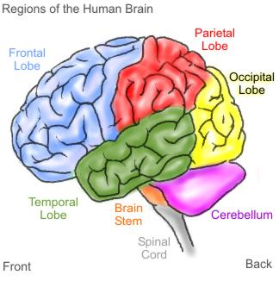
The cerebrum
The folding pattern of the brain divides the brain into four distinct lobes:
Frontal
Temporal
Occipital
Parietal

Slide 5
The cerebrum
Tracts
Bundles of nerve fibres found in the CNS
Comprised of white matter
Connect different parts of the cortex within the same hemisphere
Carry impulses between the left and right hemisphere
Connect the the cortex and other parts of the CNS (spinal cord, cerebellum, hypothalamus)

Slide 6
The cerebrum
Scientist’s have investigated the functions of various parts of the cortex by:
Studying brain waves
Stimulated particular areas and observed response
Examined changes in blood flow when a subject engages in certain mental or physical activity
Observed the effects on people who have suffered brain damage

Slide 7
The cerebrum
There are three types of functional areas:
Sensory areas interpret impulses from receptors
Motor areas control muscular movement
Association areas: intellectual and emotional processes, and memory
memories are not stored in a nerve cell they are pathways of nerve cells that is links between neurons.

Slide 8
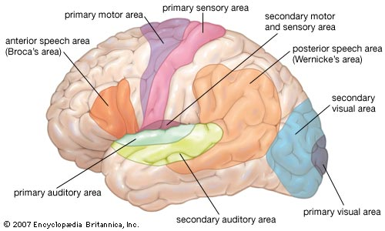
The cerebrum

Slide 9
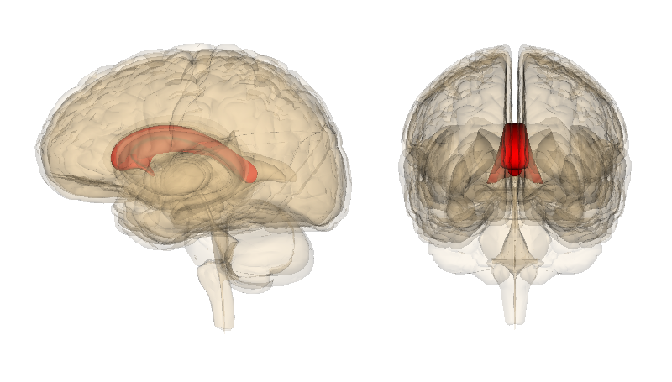
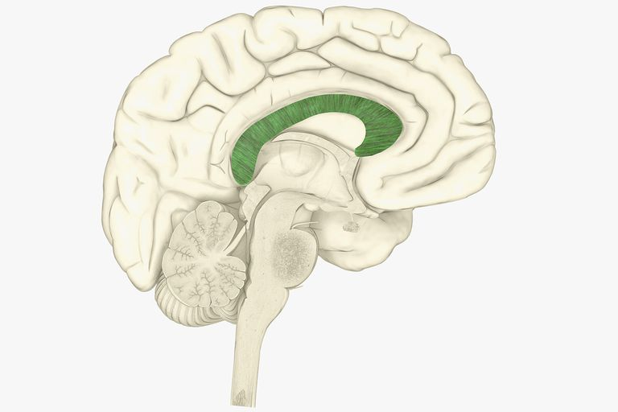
Corpus callosum
Wide band of nerve fibres
Underneath the cerebrum
Base of the longitudinal fissure
Fibres connect and allow communication between the two hemispheres

Slide 10
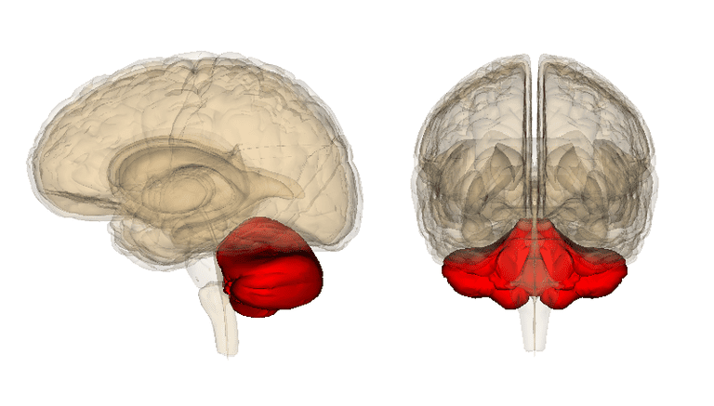
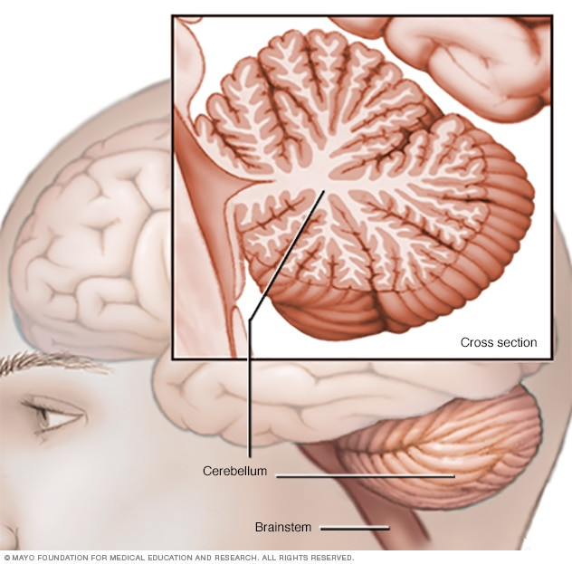
Cerebellum
Plays an important role in the function of the human body:
Controls posture and balance
Fine coordination of voluntary muscle movement
Takes place below the conscious level
Keeps our movements smooth
Takes information from stretch receptors in the muscles and the inner ear, processes this information and sends information back to the appropriate skeletal muscles
Very important in learning new motor skills

Slide 11
Hypothalamus
Mostly concerned with homeostasis
Coordinates secretion of hormones and coordination of parts of the endocrine system
Also regulates:
Autonomic nervous system (heart rate, blood pressure, parts of digestion)
Body temperature
Food and water intake
Patterns of waking and sleeping
Contraction of the bladder
Emotional responses

Slide 12
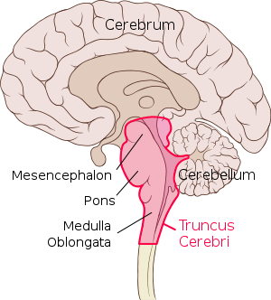
Medulla oblongata
Continuation of the spinal cord - 3cm long
Connecting the brain to the spinal cord
Contains:
The cardiac centre: regulates the rate and force of heart beat
The respiratory centre: regulate the rate and depth of breathing
The vasomotor centre: regulates the diameter of blood vessels

Slide 13
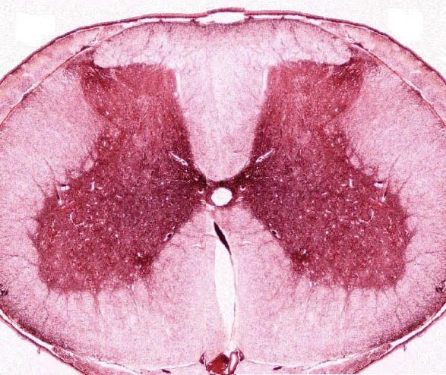
Spinal cord
Made up of a grey matter shaped like an H surrounded by white matter
In the middle is the central canal which runs the length of the spinal cord and contains CSF

Slide 14
Spinal cord
Ascending tracts
bundles of sensory axons that carry impulses toward the brain (upward)
Descending tracts
bundles of motor axons that carry impulses away from the brain to the muscles (downward)
Spinal reflexes
allow for fast automatic responses or reflexes by nerve cells in the spinal cord without input from the brain

